Slide 1
Very Important note
Public IP can change, but private IP is static

Slide 2
IP Address
IP Addresses are limited. Total number of IPv4 addresses are-
2 to the Power of 32 is equal to 4294967296
As number of devices are increased, so we are moving from 32 bit IP address to 128 bit IP address(IPv6)

Slide 3
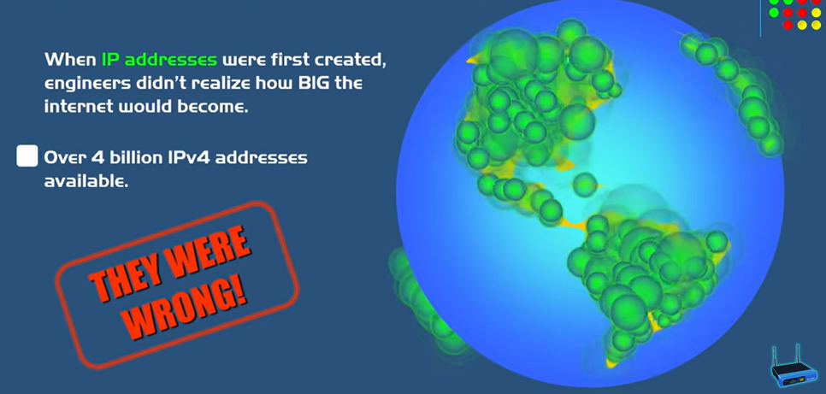

Slide 4
What is Public IP
To overcome the shortage of public IP address, private IP address is introduced.

Slide 5
Public IP vs Private IP
Public IP: Whenever you want to access the internet, you need to have public IP.
Private IP: Whenever you want to do internal activity you need to have private IP.
Example of Internal activity:
Watching Video offline, making notes, playing games.

Slide 6
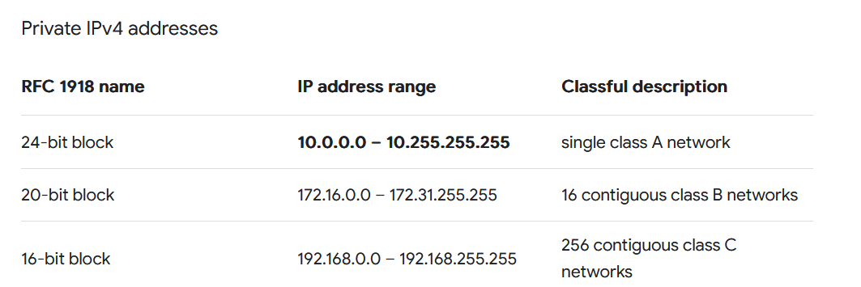
Private IP range

Slide 7
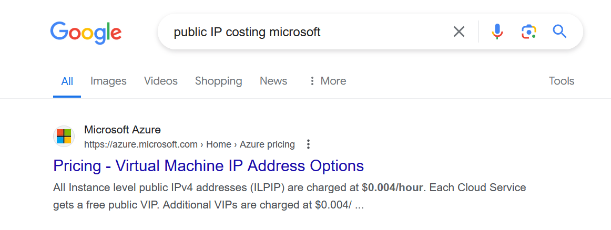
Do we need to pay money for IP address

Slide 8
How to utilized IP address
Case of Wasting IP address-
In your mobile internet is connected, but you are not using your mobile, so it’s going to block 1 Address.
You are in break, but your office Laptop is running.

Slide 9
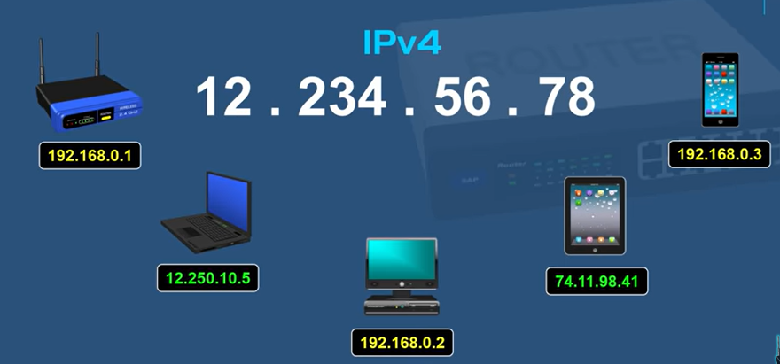
Devices with IP address

Slide 10
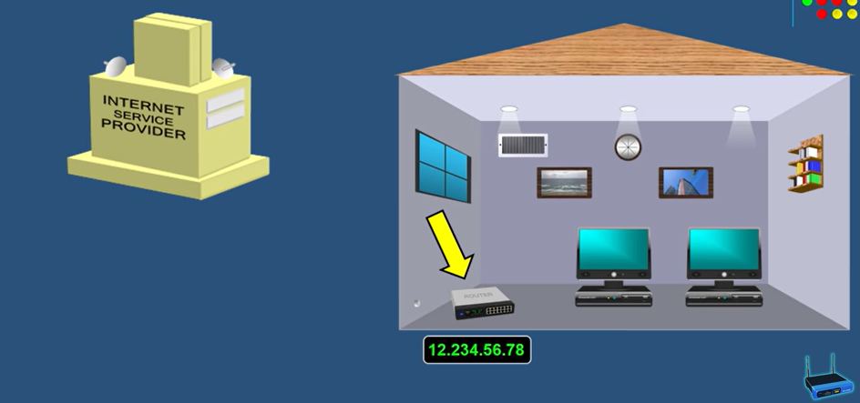
How internet assign ISP assign IP address

Slide 11
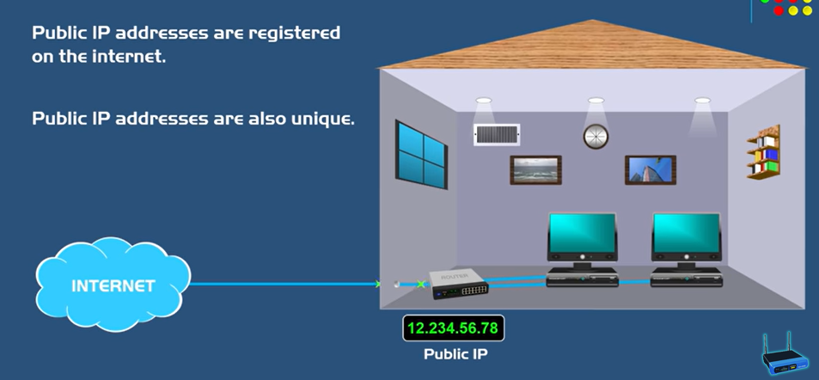
Accessing internet by rauter

Slide 12
NAT
Network Address Translation (NAT) is a method used by network devices, such as routers, to translate the IP addresses of devices in a private network to a single IP address in order to communicate with the internet. This allows multiple devices to share a single public IP address and access the internet through a single connection.

Slide 13
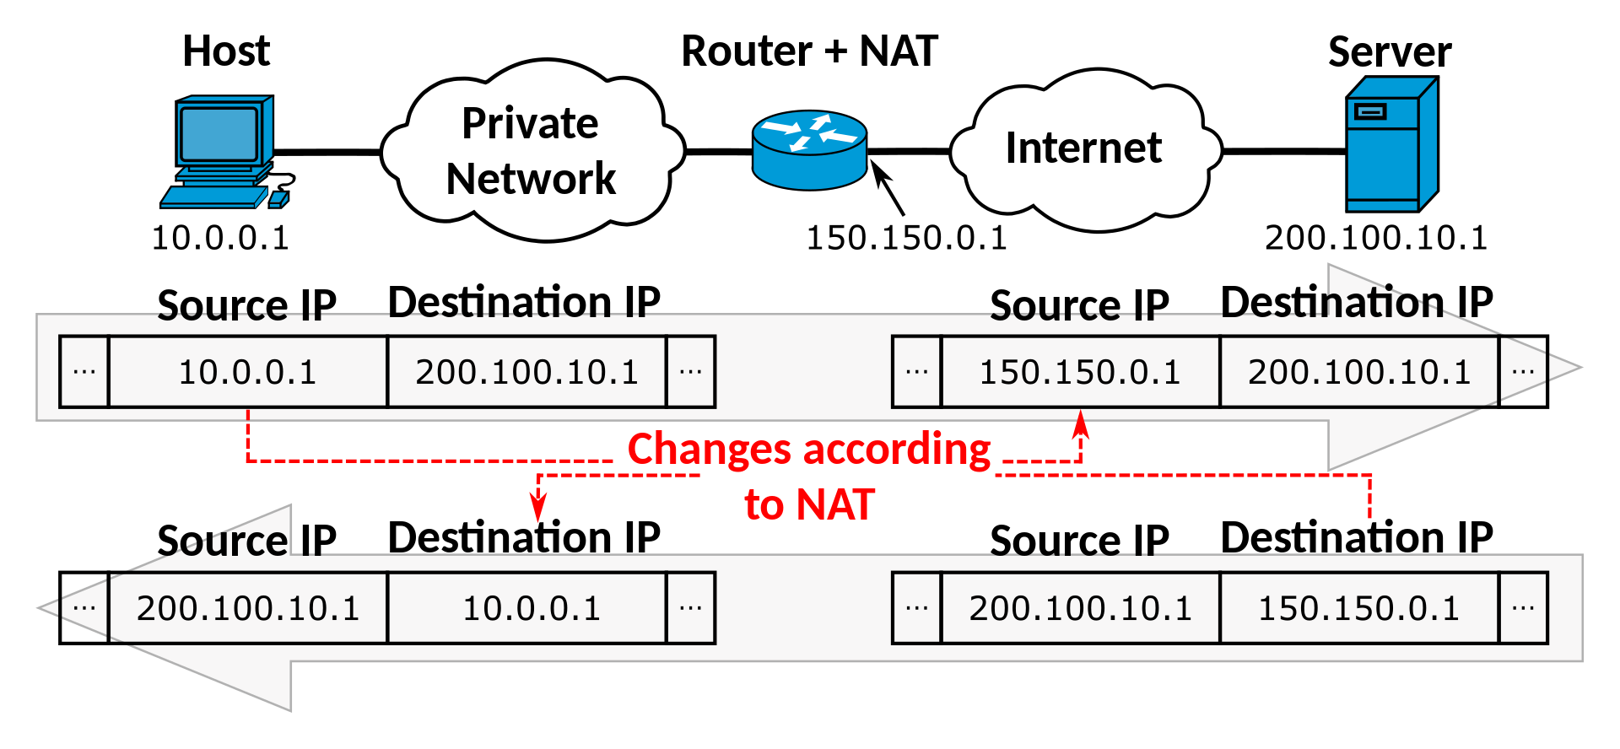
How NAT working

